Slide 1
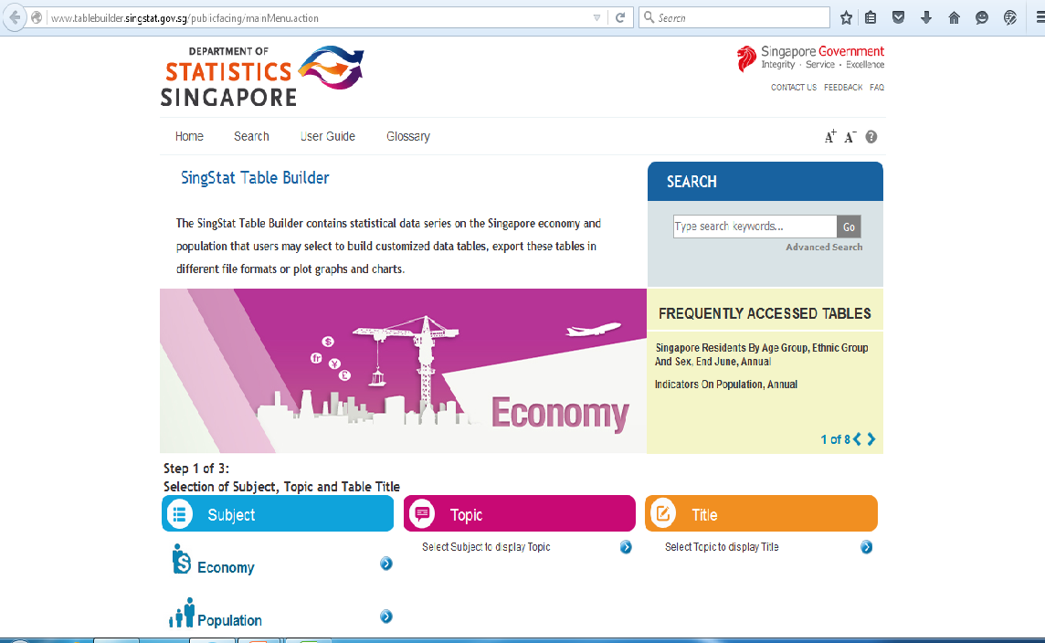
Procedure to obtain PPI data for Singapore
Go to :
Down the page, under “Subject”, click on “Economy”
http://www.tablebuilder.singstat.gov.sg/publicfacing/mainMenu.action

Slide 2
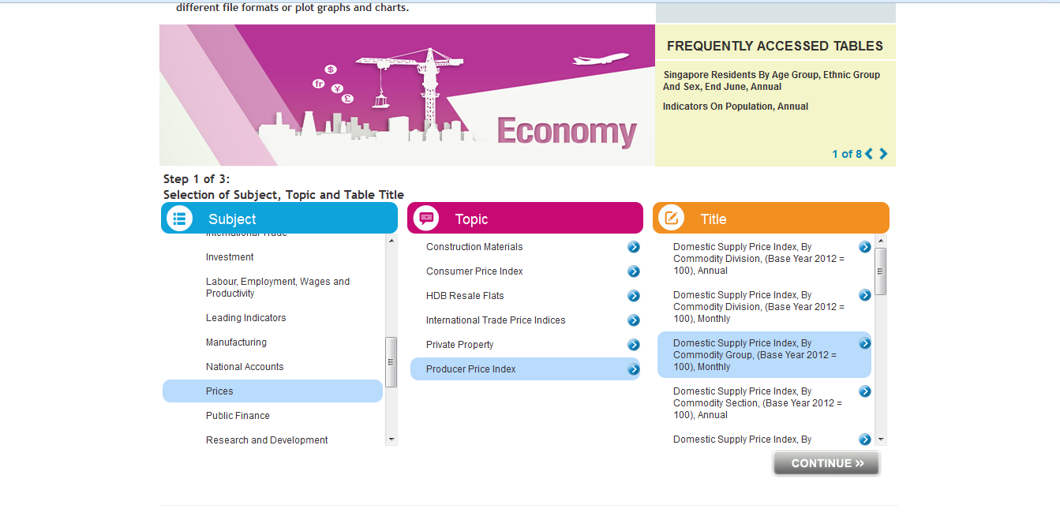
Procedure to obtain PPI data for Singapore
Scroll down and select “Prices”
Select “Producer Price Index” under “Topic”
Under “Title”, select “Domestic Supply Price Index, By Commodity Division, Monthly”
Click on “Continue”
`
`
```
`

Slide 3
Procedure to obtain PPI data for Singapore
Under “Variable 1” choose the required product(s) for which you require the PPI
Ex: Iron & Steel
Then, choose the time period for which you require the PPI
Ex: every month in 2014
Click on “Create”

Slide 4
Procedure to obtain PPI data for Singapore
The PPI data is displayed in a table down the page
The data can be downloaded by clicking on “Export”, and choosing the required file type
`
`

